Slide 1
Airbnb Report

Slide 2
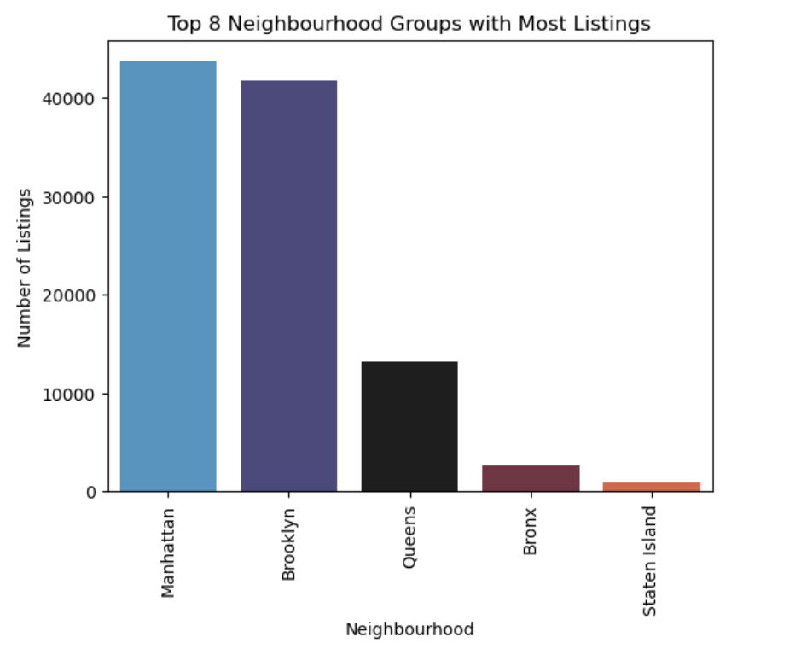
Top Neighbourhood Groups
Manhattan and Brooklyn dominate the listings, having the highest number by a large margin.
Queens has a moderate count, far lower than the top two but still significant.
Bronx and Staten Island have very few listings, showing limited Airbnb activity in these areas.

Slide 3
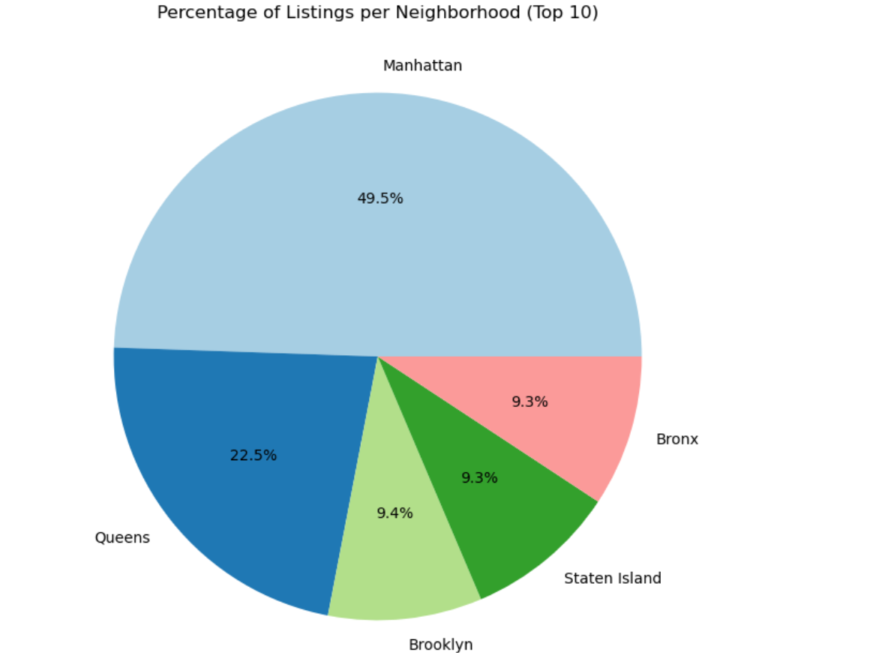
Percentage Listings per Neighbourhood
Manhattan has almost 50% of all listings, making it the biggest and most popular area for rentals.
Queens comes next with 22.5%, a solid share but much lower than Manhattan.
Brooklyn, the Bronx, and Staten Island each have around 9%, showing they have fewer listings and lower rental activity.

Slide 4
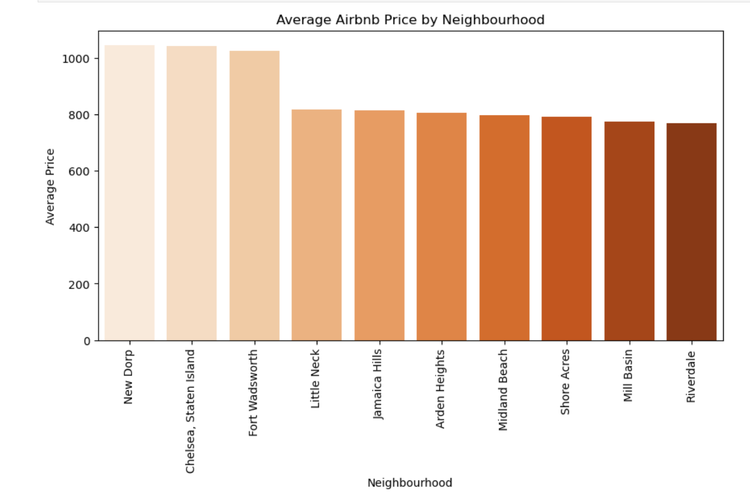
Highest Airbnb Price
New Dorp, Chelsea (Staten Island), and Fort Wadsworth have the highest prices, all above $1,000.
Prices drop for neighbourhoods like Little Neck and Jamaica Hills, which are in the $800 range.
The rest of the neighbourhoods are more affordable, mostly between $760–$810.

Slide 5
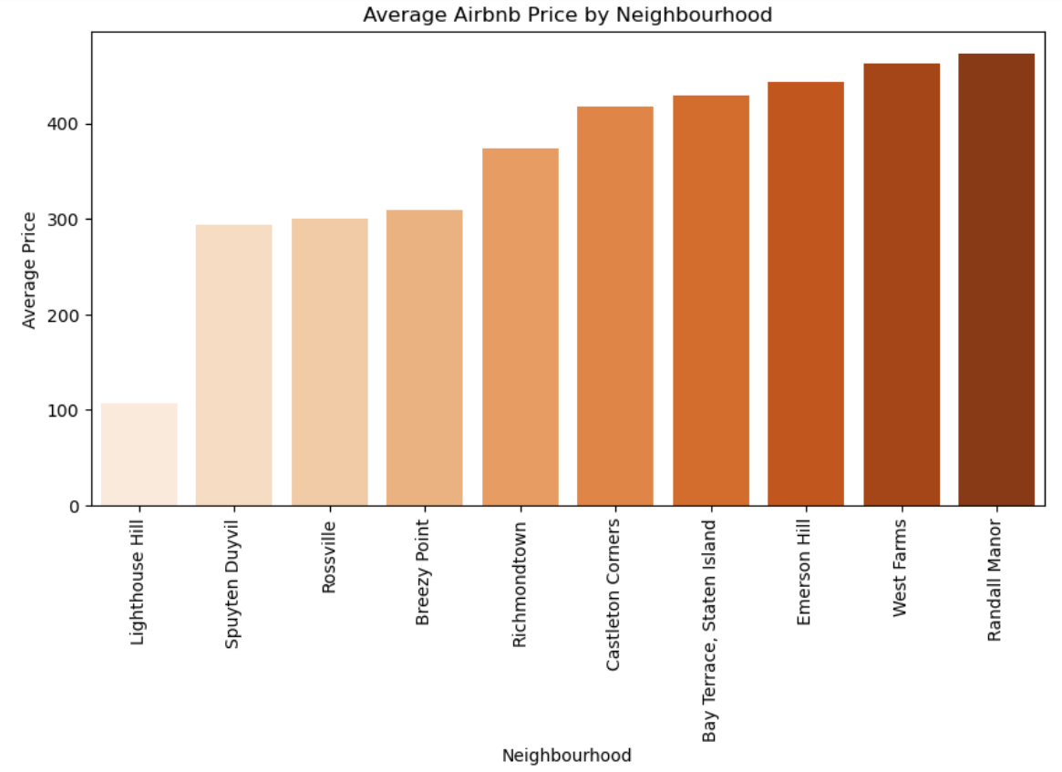
Lowest Airbnb Price
Lighthouse Hill has the lowest average price at around $100, making it the most affordable.
Spuyten Duyvil, Rossville, and Breezy Point follow next, with prices around $290–310, still on the lower end compared to other areas.

Slide 6
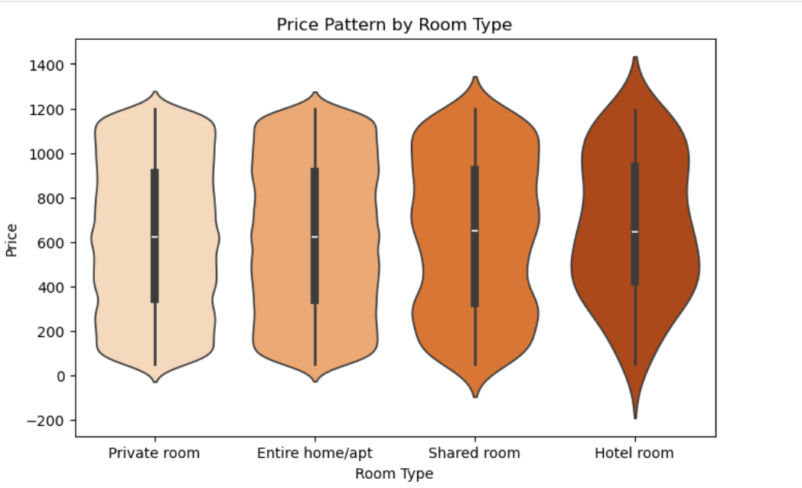
Price Pattern by Room Type
All room types vary a lot in price, but hotel rooms tend to be a bit costlier overall.
Shared rooms are usually the cheapest option, making them good for budget travellers.
Private rooms and entire homes fall in between, offering a mix of affordable and premium choices.

Slide 7
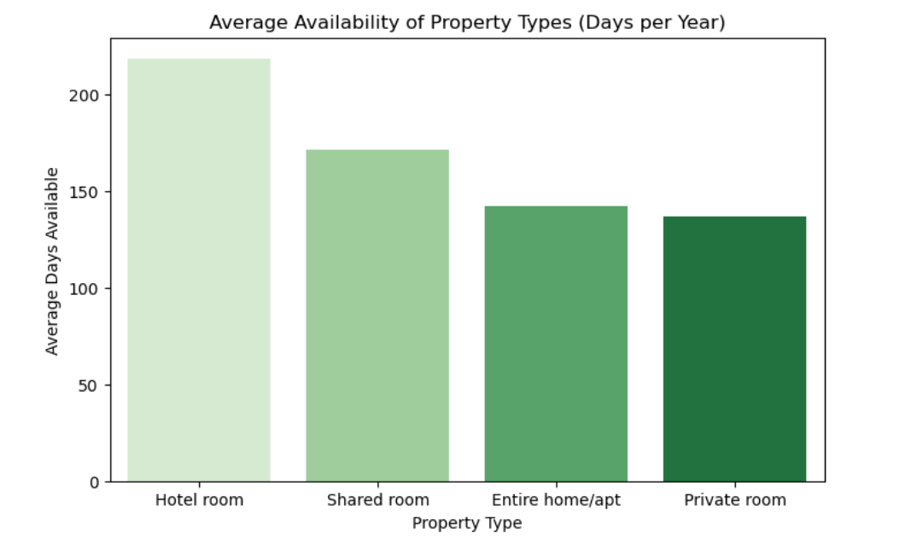
Average availability of Airbnb’s by Room Type
Hotel rooms are available for most days, meaning they’re booked less often.
Shared rooms and entire homes have moderate availability.
Private rooms are available for the fewest days, suggesting they get booked more and are in higher demand.

Slide 8
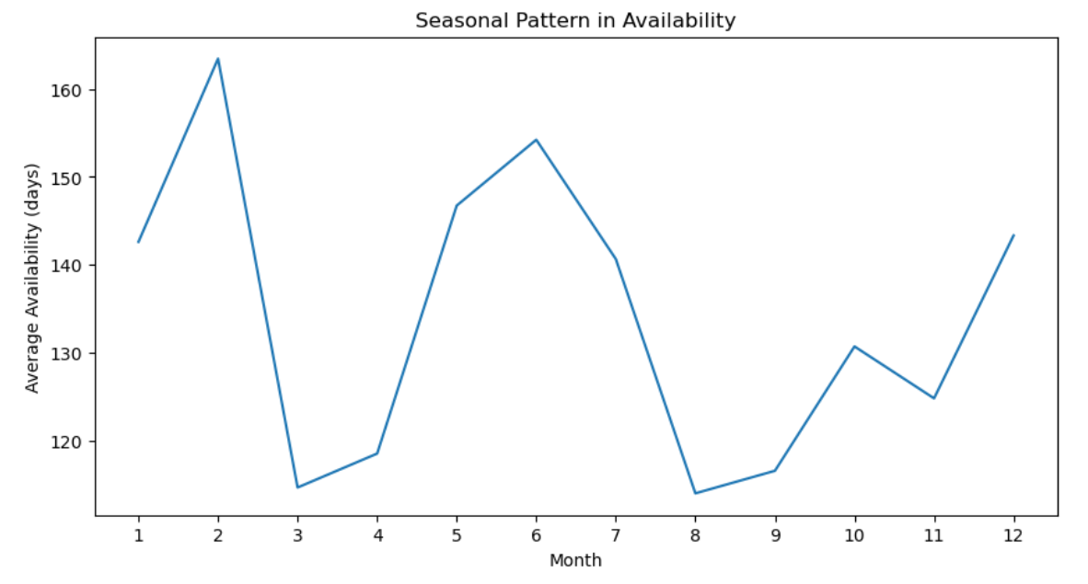
Seasonal Pattern in Availability
Availability peaks in February and June, meaning properties are easier to book during these months.
March and August have the lowest availability, showing these months are the busiest with the highest bookings.
After August, availability slowly improves again toward October and December.

Slide 9
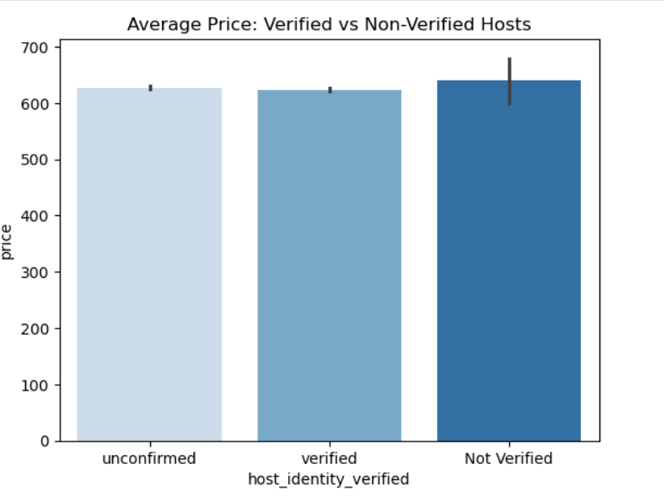
Average Price by Host Identification
Prices are almost the same whether the host is verified or not.
Verified hosts don’t charge extra; their rates are basically in the same range.
Not-verified hosts show a bit more price fluctuation, but nothing major.

Slide 10
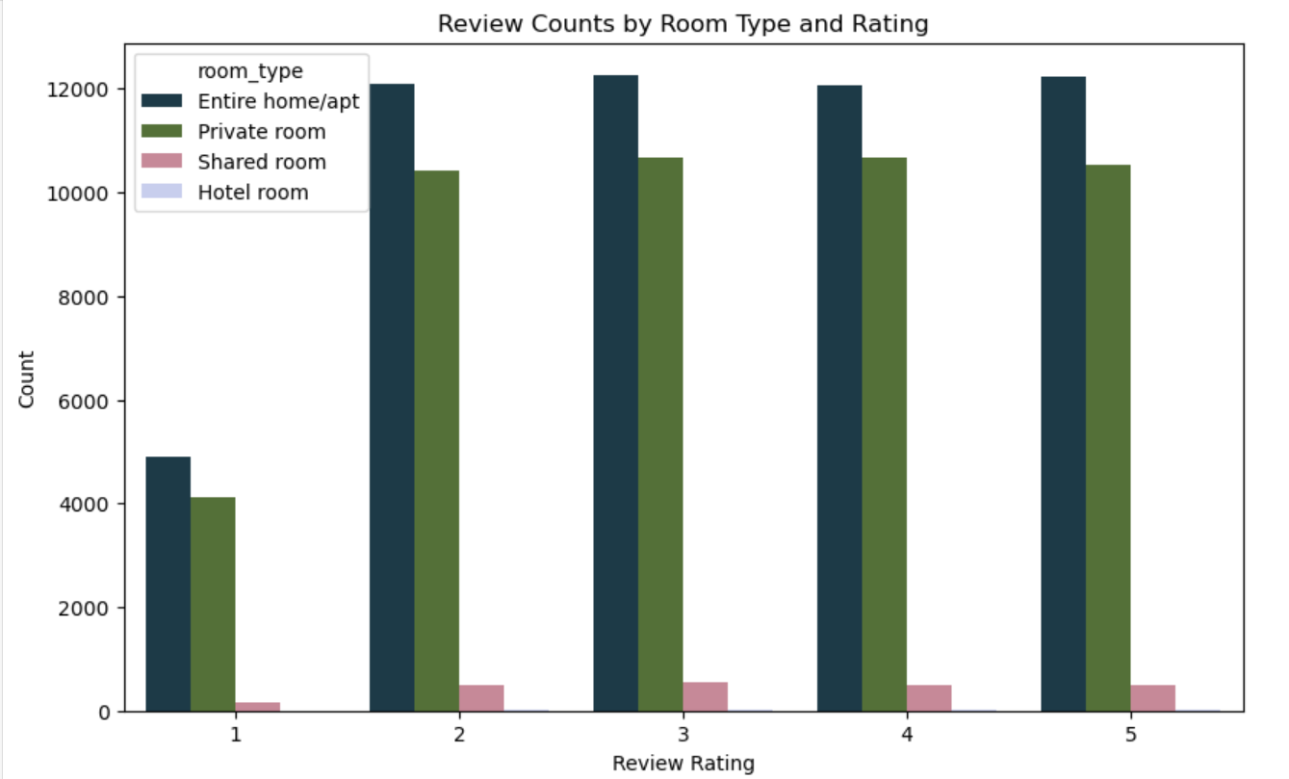
Review Counts By Room Type
Most reviews are for entire homes, people clearly prefer having the whole place.
Private rooms are also popular, but not as much as full homes.
Shared rooms and hotel rooms get very few reviews, meaning people rarely choose them.

Slide 11
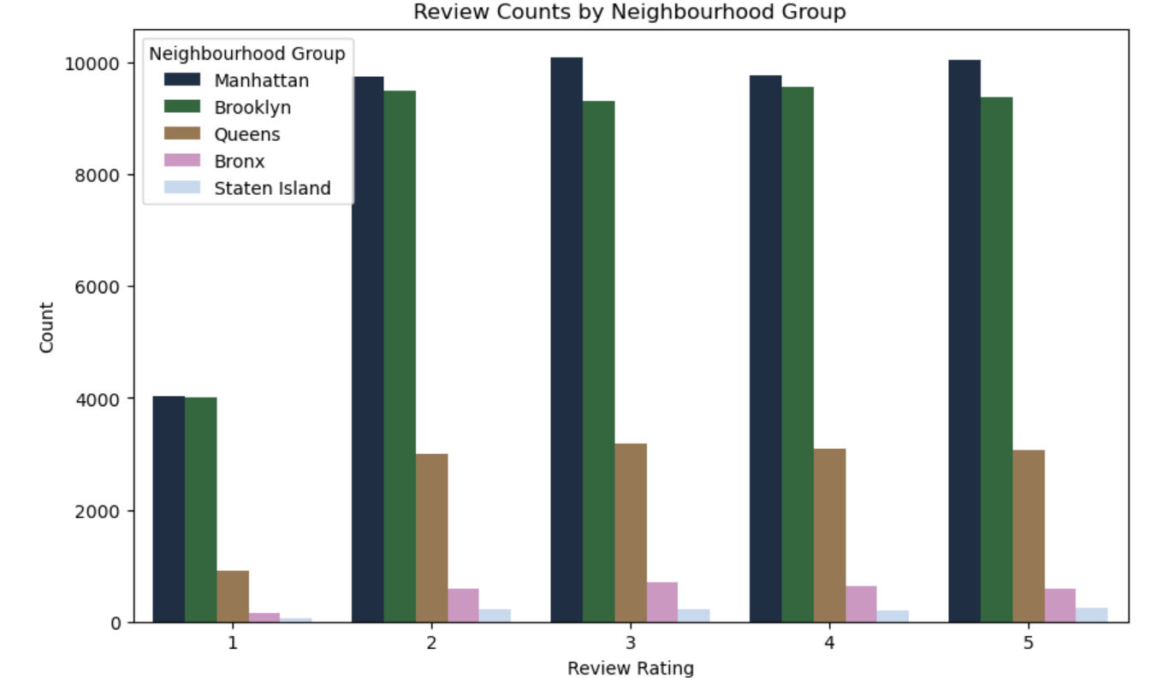
Review Counts by Neighbourhood Group
Most reviews come from Manhattan and Brooklyn these areas are the most popular.
Queens gets some reviews, but not as many.
Bronx and Staten Island get very few, meaning fewer guests stay there.

Slide 12
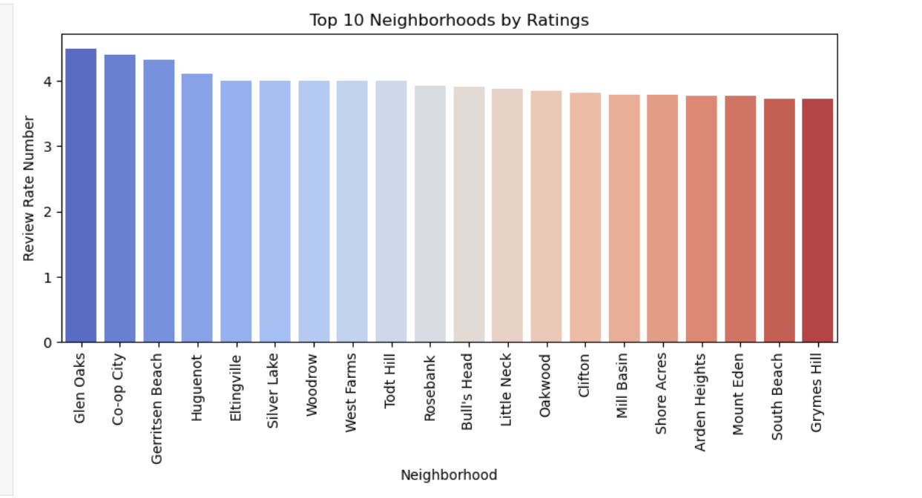
Top Neighbourhoods By Ratings
Glen Oaks, Co-op City, and Gerritsen Beach have the highest ratings — guests really love staying here.
The rest of the top neighbourhoods have very close ratings, all hovering around 4.0+.

